Slide 1
Logic Programming
it’s perfectly logical

Slide 2


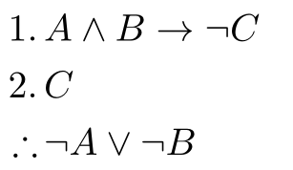
Haunted Memories of 228
You thought you could forget:
Propositional logic:
But there’s an entire paradigm of programming built on these ideas: Logic Programming!
We use statements of facts, rules, and variables to express the logical structure of a problem, then task the computer with finding a solution.
First-order (predicate) logic:
Formal inference:

Slide 3
Introduction to Prolog
The (paraphrased) logical statement “All humans are mortal. Socrates is human.” can be expressed as a single fact and a single rule in Prolog:
human(socrates). % A fact. Socrates is human. mortal(X) :- human(X). % A rule. X is mortal if they are human.
When loaded into a Prolog interpreter, we can issue queries:
“Is Socrates mortal?” ?- mortal(socrates). Yes.
“Who is mortal?” ?- mortal(P). P=socrates.
Easy!

Slide 4
Anatomy of a Prolog Program
Terms: the “expressions” of a Prolog program.
Constants: either literals, or atoms.
Variables: start with a Capital first letter, represent an unknown value. Constants and Variables comprise the simple terms.
Complex terms: facts and rules. These consist of a functor applied to one or more arguments (which are terms). Every complex term has a head; some also have a body.

Slide 5
Facts
Facts only have heads, no bodies; their arguments are simple terms.
human(socrates). number(pikachu, 25). evolves(pikachu, raichu).
Identify:
The functor name, arity, and signature.
The arguments (what type of terms are they?)
The head.
Prolog doesn’t know what “human”, “number” or “evolves” mean. The programmer decides, especially w.r.t. parameter order.

Slide 6
Unification
When we issue a query, we are asking if the query term unifies with the terms of the program. Given two terms (term1 and term2):
If they are both constants, term1 and term2 unify only if they are the same constant. (1 unifies with 1. socrates unifies with socrates.)
If term1 is a variable, then the terms unify (always). Term1 is instantiated with term2’s value. (And vice versa. X unifies with 2, instantiating X as 2. hello unifies with Y, instantiating Y as hello. W unifies with Z, and they are instantiated to the same (unknown) value.)

Slide 7
Unification, Part 2
If term1 and term2 are complex terms, they unify if and only if:
They have the same functor and same arity, and
All their corresponding arguments unify, and
The variable instantiations are compatible. (hello(X, X) does not unify with hello(neal, jaclyn), because X would be instantiated as both neal and jaclyn.)
The builtin function =/2 (operator=) tests if two things unify.

Slide 8
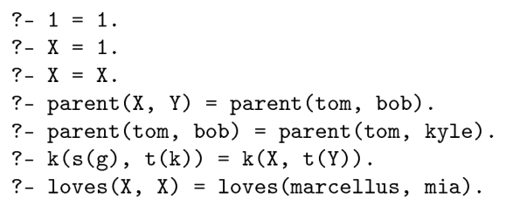

Explain which of these unify.

Slide 9
Rules
The second complex term is a rule for inferring new facts based on conditional statements.
mortal(X) :- human(X).
is equivalent to the predicate statement
E.g., “if X is human, then X is mortal.”

Slide 10
Control Flow in Rules
Prolog (kind of) lacks the control flow statements of imperative languages. Commas take the place of the “and” operator in rules:
sibling(X, Y) :- evolves(P, X), evolves(P, Y), X \= Y.
A semicolon means “or”, but often it is more clear if we simply make multiple copies of the same rule:
descendent(X, Y) :- evolves(Y, X). descendent(X, Y) :- evolves(Y, Z), descendent(X, Z).
“X is a descendent of Y if Y directly evolves into X, or if Y evolves into Z, and X is a descendent of Z.”

Slide 11
Prolog’s Computational Model

Slide 12
Goal Search
A Prolog program does not execute like an imperative language. As you have seen, we issue queries against the terms of the program, and Prolog either tells us True/False or instantiates the variables of our query with values that would make it True.
Our query is called a goal, and the process for determining its truth is called goal search or goal satisfaction.
A (relatively) easy algorithm implements goal search.

Slide 13
Goal Search Algorithm
The query is added to a goal list, then:
If the goal list is empty, terminate with success.
Otherwise, scan the terms of the program from top to bottom until some term C is found whose head unifies with the first goal in the list, G1.
If there is no such term, then terminate with failure.
If C does not have a body (if it is a fact), then instantiate any variables in the unification with G1, and remove G1 from the goal list.
If C has a body, then replace G1 with the body of C, again instantiating any variables in the unification.
Recursively repeat with the new goal list.
If the new goal list terminates with success, then terminate with success too.
If the new goal list is failure, then restore the goal list prior to unifying with C. Find a new C that unifies and repeat. (This is called backtracking.)

Slide 14
?- evolves(pikachu, X).
GL: evolves(pikachu, X).
C = evolves(pikachu, raichu). X <- raichu.
GL: empty.
Terminate: success.
Terminate: success. X = raichu.

Slide 15
?- descendent(charizard, charmander).
GL: descendent(charizard, charmander).
C = descendent(X, Y) [a]. X <- charizard, Y <- charmander.
GL: evolves(charmander, charizard).
Terminate: failure.
Backtrack.
C = descendent(X, Y) [b]. X <- charizard, Y <- charmander.
GL: evolves(charmander, Z), descendent(charizard, Z).
C = evolves(charmander, charmeleon). Z <- charmeleon.
GL: descendent(charizard, charmeleon).
C = descendent(X, Y) [a]. X <- charizard, Y <- charmeleon.
GL: evolves(charmeleon, charizard).
C = evolves(charmeleon, charizard).
GL: empty.
Terminate: success.
Success.

Slide 16
?- sibling(jolteon, X).
GL: sibling(jolteon, X).
C = sibling(X, Y). X <- jolteon, Y <- _G1.
GL: evolves(Parent, jolteon), evolves(Parent, _G1), jolteon \= _G1.
C = evolves(eevee, jolteon). Parent <- eevee.
GL: evolves(eevee, _G1), jolteon \= _G1.
C = evolves(eevee, jolteon). _G1 <- jolteon.
GL: jolteon \= jolteon.
Terminate: failure.
Backtrack.
C = evolves(eevee, flareon). _G1 <- flareon.
GL: flareon \= jolteon.
C: flareon \= jolteon.
GL: empty.
Terminate: success.
Terminate: success. X = flareon.
Congratulations!
You are now a Prolog programmer!

Slide 17
Computation in Prolog
Claim: Prolog can implement any function that your favorite imperative language can implement.
Functions returning a Boolean are easy:
isEven(X) :- mod(X, 2) is 0. evolves(pikachu, raichu). isNegative(X) :- X < 0.
But what about non-Boolean return types? Prolog doesn’t seem to support those...

Slide 18
Returning Values
How can we write the equivalent of the F# function
let squared x = x * x
in a language that can only “return” Booleans? By introducing an extra parameter to be the “return value”:
squared(X, Y) :- Y is X * X.
and allowing goal search to instantiate that parameter when X is provided:
?- squared(2, 4) True. ?- squared(3, X). X=9.
See Repository/Prolog/Functions for more...

Slide 19
Lists

Slide 20
List Syntax
Prolog uses the same persistent list structure as F#, but comma-separated instead of semicolons.
Instead of :: for “cons”, we use |
A = [1, 2, 3], B = [4 | A], % B is [4, 1, 2, 3] C = [9, 8, 7 | B] % C is [9, 8, 7, 4, 1, 2, 3]
The real power and excitement of lists comes from unification...

Slide 21
Unifying (Matching) Lists
To unify two lists, their corresponding explicit members must unify, and their tails must unify:
[1, 2, 3] unifies with [1, 2, 3].
[1, 2, 3] unifies with [1 | [2, 3]].
[1, 2, 3] unifies with [A, B, C], instantiating A<-1, B<-2, C<-3.
[1, 2, 3] unifies with [1 | T], instantiating T<-[2, 3].
[1, 2, 3] unifies with [1, A | T], instantiating A<-2, T<-[3].
[1] unifies with [1 | T], instantiating T<-[].
[1] does not unify with [1, 2]
[H | T] unifies with any non-empty list.

Slide 22
Rules With Lists
Now we can have some fun!
isEmpty([]). ?- isEmpty([1]). False.
contains([X|_], X). contains([_|T], X) :- contains(T, X). ?- contains([3, 1, 4], 1). True. ?- contains([3, 1, 4], X). X=3;X=1;X=4.

Slide 23
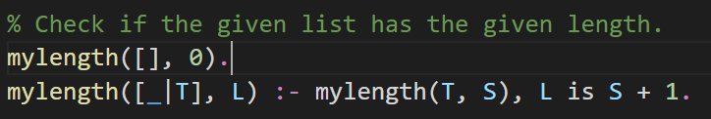
?- mylength([1, 2, 3, 4], X).
GL: mylength([1, 2, 3, 4], X).
C = mylength([_|T], L). T<-[2, 3, 4], L<-X<-_G1.
GL: mylength([2, 3, 4], S), _G1 is S + 1.
C = mylength([_|T], L). T<-[3, 4], L<-S<-_G2.
GL: mylength([3, 4], S), _G2 is S + 1, _G1 is _G2 + 1.
C = mylength([_|T], L). T<-[4], L<-S<-_G3.
GL: mylength([4], S), _G3 is S + 1, _G2 is _G3 + 1, _G1 is _G2 + 1.
C = mylength([_|T], L). T<-[], L<-S<-_G4.
GL: mylength([], S), _G4 is S + 1, _G3 is _G4 + 1, _G2 is _G3 + 1,
_G1 is _G2 + 1.
C = mylength([], 0). S<-0.
Now… _G4 is 0 + 1 = 1, _G3 is 1 + 1 = 2, _G2 is 2 + 1 = 3, _G1 is 3 + 1 = 4.
Success. X = 4.

Slide 24
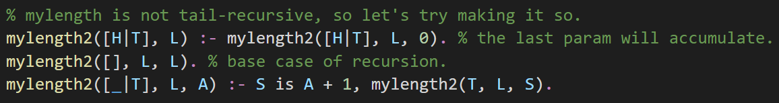
?- mylength2([1, 2, 3, 4], X).
GL: mylength2([1, 2, 3, 4], X).
C = mylength2([H|T], L). H<-1, T<-[2, 3, 4], L<-X<-_G1.
GL: mylength2([1, 2, 3, 4], _G1, 0).
C = mylength2([_|T], L, A). T<-[2, 3, 4], L<-_G1, A<-0.
GL: S is 0 + 1, mylength2([2, 3, 4], _G1, S).
GL: mylength2([2, 3, 4], _G1, 1).
C = mylength2([_|T], L, A). T<-[3, 4], L<-_G1, A<-1.
GL: S is 1 + 1, mylength2([3, 4], _G1, S).
C = mylength2([_|T], L, A). T<-[4], L<-_G1, A<-2.
GL: S is 2 + 1, mylength2([4], _G1, S).
C = mylength2([_|T], L, A). T<-[], L<-_G1, A<-3.
GL: S is 3 + 1, mylength2([], _G1, S).
C = mylength2([], L, L). L<-_G1, L<-4, _G1<-4, X<-4.
Success. X=4.

Slide 25
?- mylength2(X, 3).
GL: mylength2(X, 3).
C = mylength2([H|T], L). X<-[_G1|_G2], L<-3.
GL: mylength2([_G1|_G2], 3, 0).
C = mylength2([_|T], L, A). T<-_G2, L<-3, A<-0.
GL: S is 0 + 1, mylength2(_G2, 3, S).
C = mylength2([_|T], L, A). _G2<-[_G3|_G4], L<-3, A<-1.
GL: S is 1 + 1, mylength2(_G4, 31, S).
C = mylength2([_|T], L, A). _G4<-[_G5|_G6], L<-3, A<-2.
GL: S is 2 + 1, mylength2(_G6, 3, S).
C = mylength2([], L, L). _G6<-[], L<-3.
Success!
Success! _G4<-[_G5]
Success! _G2<-[_G3, _G5]
Success. X<-[_G1,_G3,_G5]

Slide 26
Concurrent Programming
get with the times

Slide 27
Motivation
Suppose I have a simple program that writes 1,000 MB of data to disk, while also creating a rainbow effect on some LEDs attached to the computer. A simple implementation:
void main() { write_file(); rainbow(); }
Problem! write_file() is a blocking operation; disk I/O is much slower than the CPU, so write_file() takes a very long time to complete, and we cannot progress to rainbow() until write_file() is done.
We have two tasks that we want to complete, and we want their lifetimes (the time in which progress is being made on the task) to overlap. This is called concurrency; the two functions are concurrent tasks.

Slide 28
Single-Application Concurrency
In an environment where only a single application runs on the CPU (embedded devices, old operating systems, …), concurrency is achieved by subdividing tasks and making incremental progress in a loop:
void main() { while (file_not_done && lights_not_done) { save_next_file_chunk(); // save a small part of the file. next_rainbow_color(); // make small progress on the rainbow. } }
It’s doable, but hard for large applications. And not all tasks can be subdivided.
Things are much better now, with multi-application operating systems.

Slide 29
Modern Operating Systems
A modern operating system allows multiple processes to run “at the same time”. Each process:
Runs the code form an executable program.
Has its own memory space. (Static, heap, registers.)
Consists of one or more threads
A thread executes a function in the program, including all functions it calls, until the function terminates.
Each thread has its own stack (memory).
Threads are given “time slices” on the CPU to execute. When the slice is over, the OS suspends the thread and resumes a different thread, many many times every second. (context switching)

Slide 30
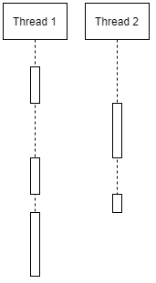
Concurrency With Threads
In a modern (threaded) operating system, concurrency is simple: create a thread for each task. The OS handles switching between threads so that they all make progress simultaneously*.
void main() { Thread *t1 = start_thread(write_file); Thread *t2 = start_thread(rainbow); wait_for_threads(t1, t2); }
*Note: only one thread can actually execute on a CPU at any given time.

Slide 31
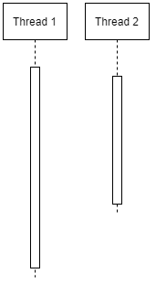
Multi-Processor Systems
Modern CPUs have multiple cores, each of which can (largely) independently execute a single thread. Older systems had multiple single-core CPUs, that likewise each executed a single thread.
Either way, we now have proper parallel execution: multiple tasks can be run physically at the same time on different cores/processors.

Slide 32

Multiple Systems
And why stop with a single system? We can also achieve concurrency with distributed systems, where our tasks run on multiple independent devices.

Slide 33
Vocabulary Summary
Programmers (and languages!) should distinguish between:
Concurrency: when tasks have overlapping lifespans.
Parallelism: when tasks can be executed simultaneously (in parallel) on a multi-processor (multi-core) system.
Distribution: when tasks are run on multiple physical devices.

Slide 34
Classic Problems in Concurrency
bool withdraw(int amount) { if (balance >= amount) { balance -= amount; return true; } return false; }
Suppose balance=500; and withdraw(400) and withdraw(200) are executed concurrently. What are the three possible outcomes?
CRITICAL SECTION

Slide 35
Issues to Solve
All programs with concurrency need to solve two broad issues:
Communication: how does a task receive data produced/provided by another task, i.e., how do parameters and return values get passed between tasks?
Synchronization: how do we control the relative order in which operations occur in different tasks, i.e., how do we restrict access to critical sections?
It’s not just programmers who decide these answers… languages can make concurrency easier (or harder!) with careful design decisions.

Slide 36
Major Models of Concurrency
Languages approach intra-process concurrency in two different ways:
Shared memory: some/all of a program’s variables are accessible from multiple threads. (Java, C, C++, any language with Thread types.)
Message passing: threads have separate memory spaces. One thread “sends” data to another, both for parameters and return values. (JavaScript: promises, async/await. F#: async. Go/Rust: channels.)

Slide 37
Shared Memory
Shared memory allows multiple threads to assign or call methods on a mutable static or heap value. (Each thread has its own stack.)
To communicate, one thread mutates the shared memory, and another thread observes that mutation.
(Example: Repository/Java/FibMultithreaded)
To synchronize, a thread joins (waits for exit) a thread that must finish first; or locks a critical section before accessing it, and suspends if another thread has already locked.

Slide 38
Message Passing
Shared memory is necessary because threads can’t return values. But what if they could?
In languages that use a message passing model, threads send and receive “messages” (objects) instead of sharing memory. If one thread produces a value to be used by another, it sends that value which is received by the second. (Communication.)
Synchronization is implicit: a message must be sent before it can be received. If Task A must finish before Task B, then A sends a message to B when it has finished.

